Slide 1
Regularization
Regularization
Limit the capacity of a model to avoid over-fitting
Extend the cost-function by adding a penalization term
J˜(θ; X, y ) = J(θ; X, y ) + αΩ(θ)
α ∈ [0, ∞) is also known as the regularization penalty
Regularize the neuron weights, but not the bias terms
For simplicity use the same α for all layers

Slide 2
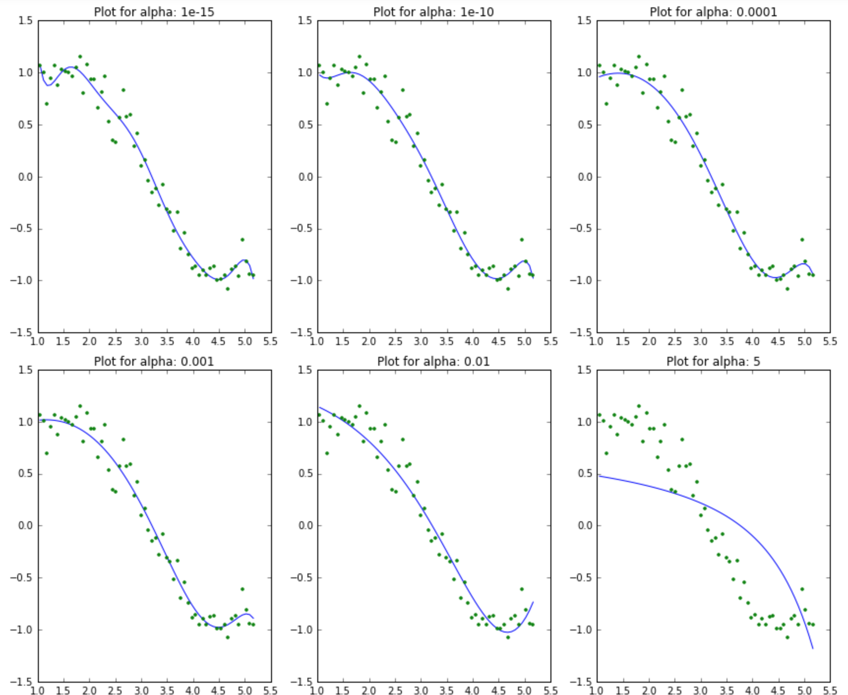
Motivating Regularization
Regularization
Figure 1: Regularizing polynomial regression (order 15), Source
www.analyticsvidhya.com

Slide 3
L² Regularization
Regularization
The L² regularization penalizes high w values
J˜(w ; X, y ) = J(w ; X, y ) + ^{α}w ^{T} w
2
Gradients of the cost w.r.t. the weights are
∇_{w} J˜(w ; X, y ) = ∇_{w} J(w ; X, y ) + αw
Remember ∇_{w} J(w ; X, y ) is computed through back-propagation
A simple gradient descent step with a learning rate ϵ is:
w ← w − ϵ (∇_{w} J(w ; X, y ) + αw )

Slide 4
L¹ Regularization
Regularization
The L¹ regularization:
J˜(w ; X, y )
= J(w ; X, y ) + α||w ||₁
Σ
= J(w ; X, y ) + α |w |
k
k
Gradients of the cost w.r.t. the weights are
(
!
1 if w > 0
∇_{w} J˜(w ; X, y ) = ∇_{w} J(w ; X, y ) + α
k
−1 if w_{k} ≤ 0
A simple gradient descent step with a learning rate ϵ is:
(
!!
1 if w > 0
w ← w − ϵ ∇ J(w ; X, y ) + α
k
−1 if w_{k} ≤ 0
w

Slide 5
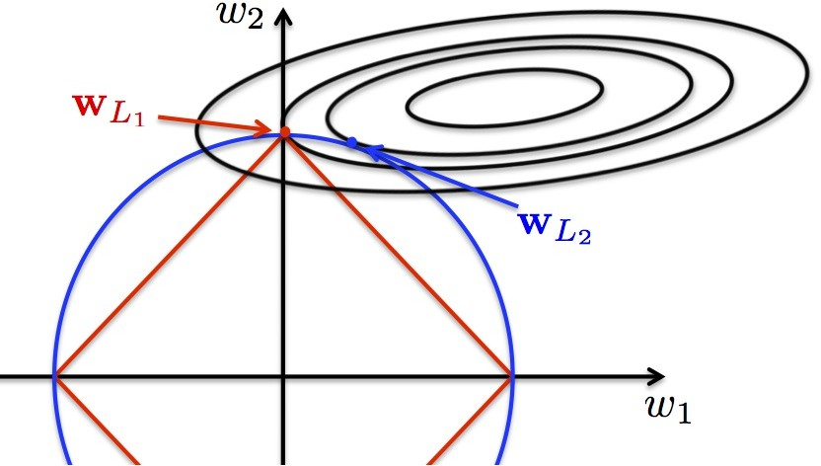
L1 and L2 Regularizations - Illustration of the Principle
Regularization
Figure 2: Competing objective terms. i) the blue line represents the L2 regularization, ii) the red line represents the L1 regularization, while iii) solid lines represent the cost function. Source: g2pi.tsc.uc3m.es

Slide 6
Constraint Optimization
Regularization
The standard regularized objective:
J˜(θ; X, y ) = J(θ; X, y ) + αΩ(θ)
A constrained problem forces Ω(w ) < k as:
J˜(θ, α; X, y ) = J(θ; X, y ) + α (Ω(θ) − k)
The solution is by deriving a new objective:
_{θ}∗
= argmin max [J(θ; X, y ) + α (Ω(θ) − k)]
θ
α,α≥0

Slide 7
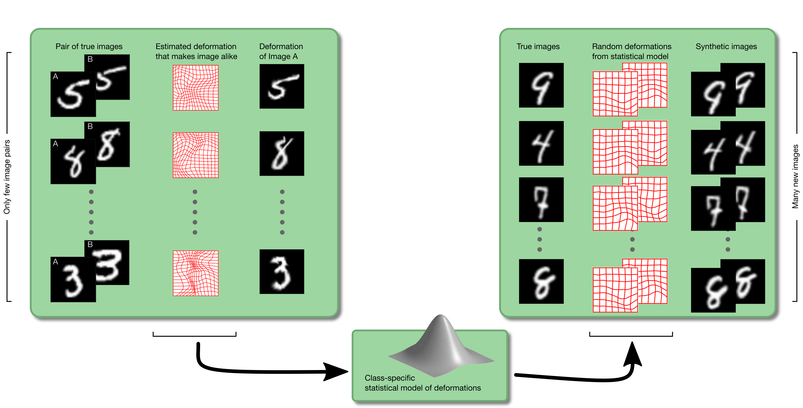
Dataset Augmentation (Noise to Input)
Regularization
Train the network with more data to improve generalization
Create ”fake” data by perturbing existing training set instances
Effective for object recognition:
⁾ Translation, rotation, scaling of images; or deformation strategies:
Figure 3: An illustrative strategy for digit images augmentation, Source: compute.dtu.dk

Slide 8
Noise Robustness (Noise to Weights)
Regularization
Noise to weights reduces over-fitting and is used primarily with recurrent neural networks
Consider a regression problem:
J = E_{p(x,y )} ^{h}(yˆ(x ) − y )^{2i}
Adding a perturbation ϵ_{w} ∼ N (0, ηI ) to the network weights yield a perturbed prediction yˆ_{ew} (x ), such that:
J = E
= E
h i
(yˆ (x ) − y )
2
p(x,y,є )
є
w
w
2 2
yˆ (x ) − 2y (x )y + y
p(x,y,є )
є є
w w w
The optimization of this objective for small η is equivalent to adding
an additional regularization ηE
||∇ yˆ(x )||
2
p(x,y,є )
w
w

Slide 9
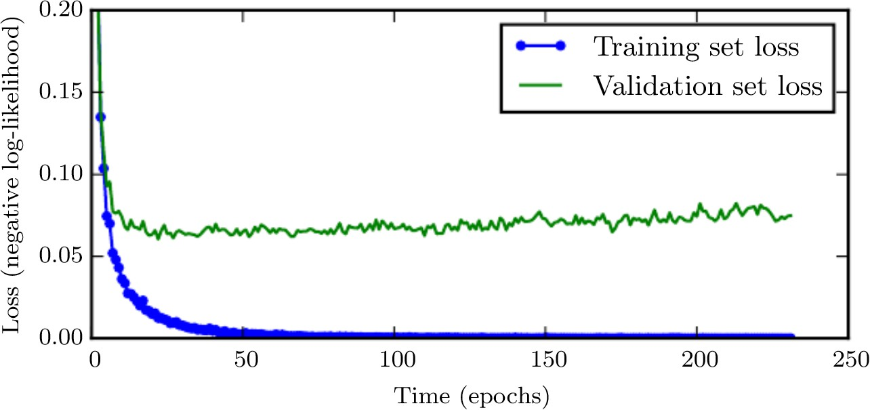
Early Stopping - Motivation
Regularization
Figure 4: There is a better generalization in the earlier epochs of the optimization, Source: Goodfellow et al., 2016

Slide 10
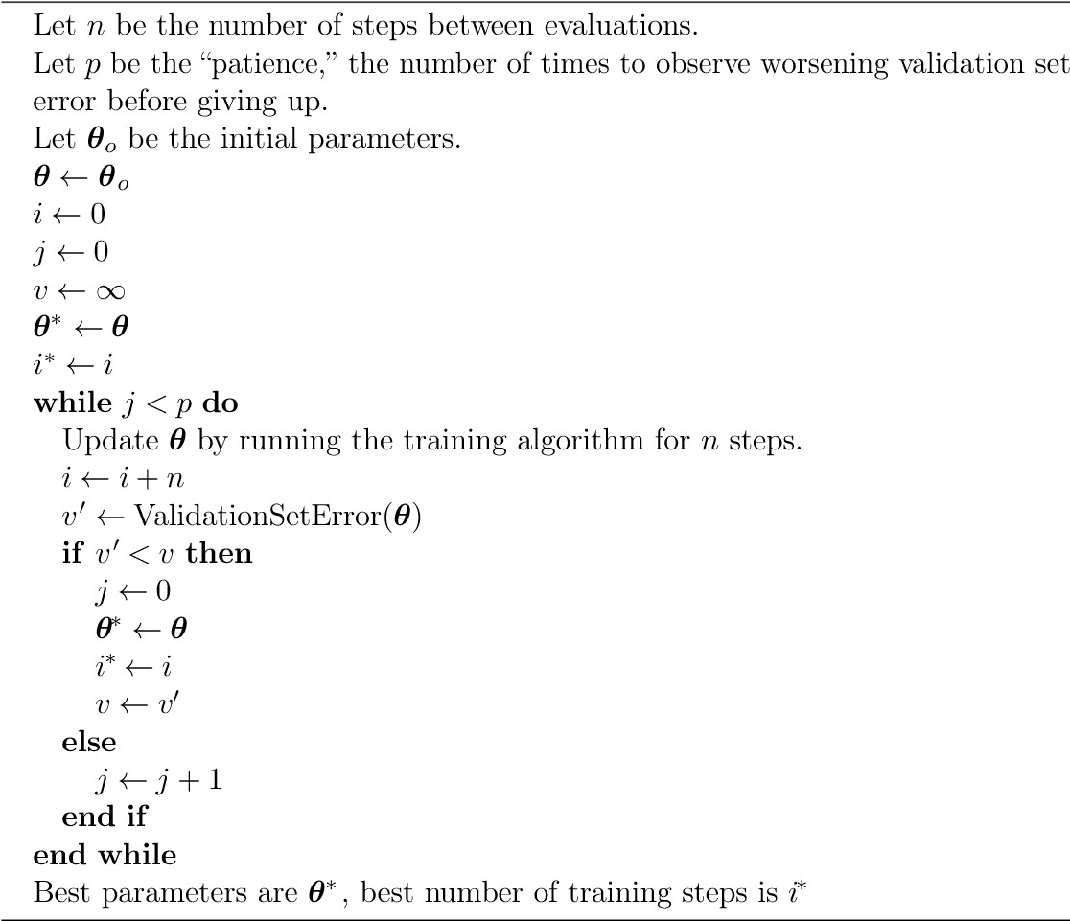
Regularization
Early Stopping (Source: Goodfellow et al., 2016)

Slide 11
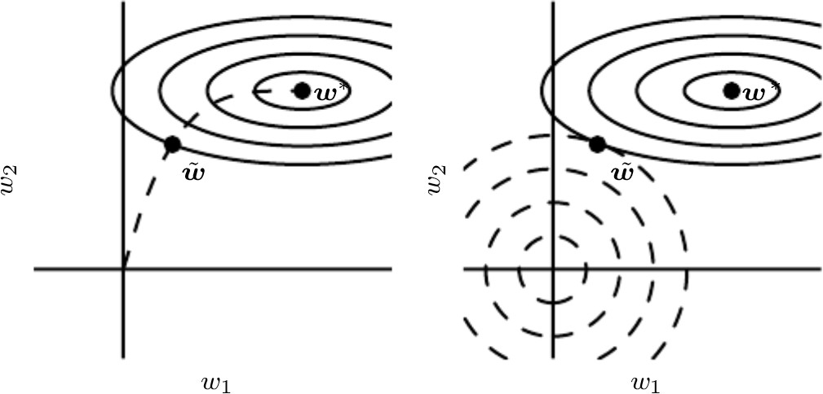
Early Stopping as a Regularizer
Regularization
Figure 5: Effect of early stopping (left) on the parameter weights, compared to L2 regularization (right). Source: Goodfellow et al., 2016

Slide 12
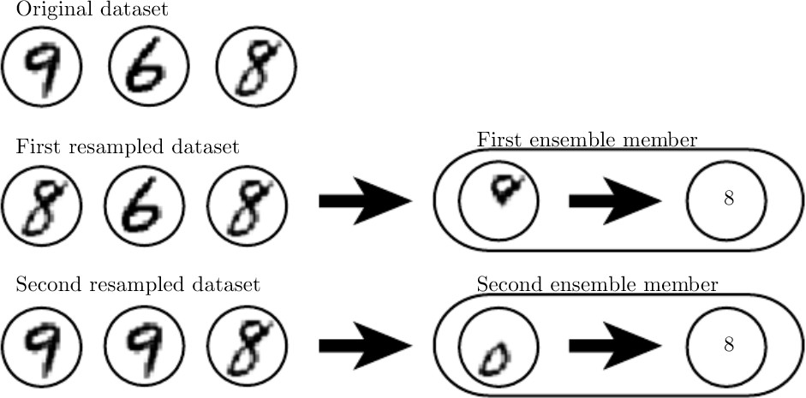
Bagging (Boostrap Aggregating)
Regularization
Sample the training dataset with replacement and create subsets
Learn one model for each subset and then aggregate the predictions of each model
Also known as ensemble methods with model averaging
Bagging helps reducing the generalization error
Figure 6: Classify 8-vs-others in digit recognition, Source: Goodfellow et al., 2016

Slide 13
Understanding Bagging
Regularization
Ensemble models make errors ϵ_{i} , i = 1, . . . , k in a regression task:
⁾ Each ϵ_{i} is drawn from a multivariate normal distribution with mean 0,
2
variance E ϵ = v and covariances E [ϵ ϵ ] = c
i
i j
Σ
k
The overall error of an ensemble is
1
k
ϵ
i
i =1
The expected squared error of the ensemble is
 _{!2}
 , _{Σ} 
k
k
Σ
Σ
1
k k
_{E} 

1
 
1
k − 1
ϵ_{i} = E
2
ϵ + ϵ_{i}ϵ_{j}  = _{k} v +
c
2
i
k
i =1 i =1 j/=i
(A) If errors are perfectly correlated, c = v then squared error is v
(B) If errors are perfectly uncorrelated, c = 0 then squared error is ^{v}
k
In (A) ensemble doesn’t help and in (B) the error is reduced linearly

Slide 14
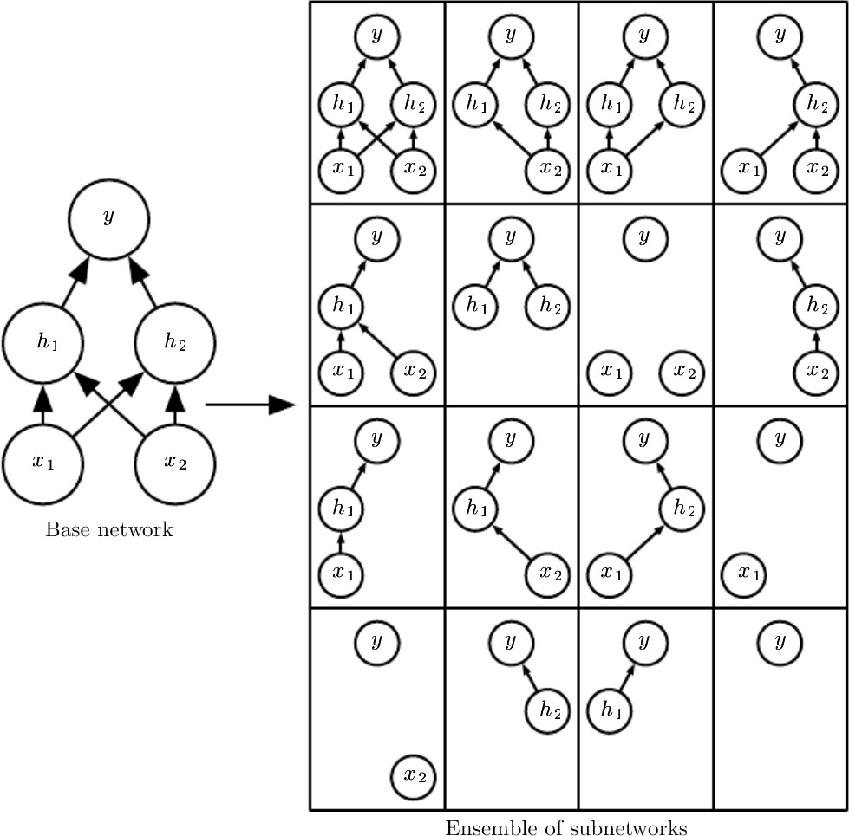
Regularization
Dropout - Bagging of random neural subnetworks

Slide 15
Dropout Mechanism
Regularization
Dropout a node by multiplying its output by zero
Only input and hidden nodes are dropped out
Minibatch-based learning
⁾ for each batch of training instances we sample different binary masks for input/hidden units
Typically an input unit is included with a probability of 0.8 and hidden unit with a probability of 0.5
Compute back-propagation as usual but multiplying the activations by the mask

Slide 16
Dropout - Forward computations (i)
Regularization
For every mini-batch of the training set,
For input layer sample drop-out masks µ⁽⁰⁾ ∼ Bernoulli(p_{input})_{N}
For hidden layer l = 1, . . . , L sample µ^{(l)} ∼ Bernoulli(p_{hidden})_{N}
l
_{h}(1)
_{h}(2)
=
_{g} (1) _{W} (1)^{T} _{x} ^{O} _{µ}(0) _{+ b}(1)
=
_{g} (2) _{W} (2)^{T} _{h}(1) ^{O} _{µ}(1) _{+ b}(2)
. . .
=
_{h}(L)
_{g} (L) _{W} (L)^{T} _{h}(L−1) ^{O} _{µ}(L−1) _{+ b}(L)
where ^{N} is the element-wise multiplication.

Slide 17
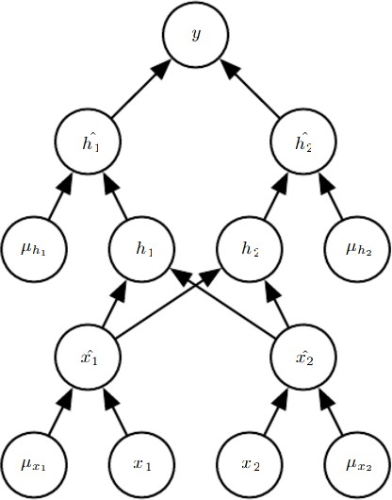
Dropout - Forward computation (ii)
Regularization
Figure 7: Illustrating drop-out masks, Source: Goodfellow et al., 2016

Slide 18
Dropout - Back-propagation
Regularization
When running backpropagation mulptiply gradients by the masks:
∂L(y, h^{(L)})
∂L(y, h^{(L)}) ∂a^{(l)}
=
i
_{∂W} (l)
_{∂a}(l)
_{∂W} (l)
j,i
i
j,i
∂L(y, h^{(L)})
(l−1) (l−1)
=
h_{j} µ_{j}
(l)
∂a_{i}
(
(L)
(l−1) (l−1)
if l − 1 > 0
if l − 1 = 0
∂L(y, h ) h µ
=
j j
_{∂a}(l)
x_{j}µ_{j}
(0)
i
Remember ^{∂L(y,h(L))} are stored during back-propagation
_{∂a}(l)
i

Slide 19
Dropout - Inference
Regularization
Use the weight scaling rule for inference:
O
_{h}(1)
_{h}(2)
(1) (1)
T
_{+ b}(1)₎
= g (W
x p →
input_{N}
=
_{g} (2)_{(W} (2)^{T} _{h}(1) ^{O} _{p}
→
_{+ b}(2)₎
hiddenN1
. . .
=
_{h}(L)
_{g} (L)_{(W} (L)^{T} _{h}(L−1) ^{O} _{p}
→
_{+ b}(L)₎
hiddenN_{L−1}

